Slide 1
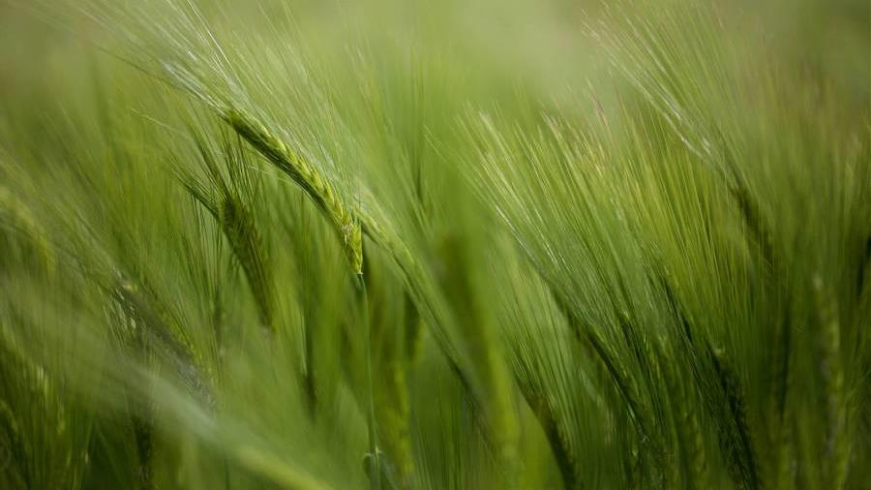
“CROPUP” - Crop yield prediction and recommendation system with Geographical data using dNN and xgboost
GUIDE:
Dr M Sobhana
Sr. Assistant Professor
Pragathi Tummala - 188W1A0542
Sruthi Kakumani - ​188W1A0523

Slide 2
ABSTRACT
Agricultural management is significant in a populous country like India. Farmers must have advance knowledge about predicted crop production and crop condition within particular area in order to make economic and farming decisions. To generate the yield, we consider the factors like temperature, humidity, pressure, NDVI values, Latitude, Longitude etc. When cultivating a particular kind of crop on a specific type of soil, there are a number of factors to be considered. A crop recommender system considers soil properties such as N, P, and K, as well as other factors like rainfall, humidity, and pH levels, to choose the best crop for the farm. This paper presents a predictive algorithm that would estimate crop yield using deep neural networks with geographical data. A recommendation system was built using machine learning algorithm like XGBoost to recommend the suitable crop. A user interface named CROPUP has been developed to scale up crop productivity and efficiency using the proposed algorithms.
Keywords: Geographical data, Crop Yield, Deep Neural Networks, Recommendation, XGBoost.

Slide 3
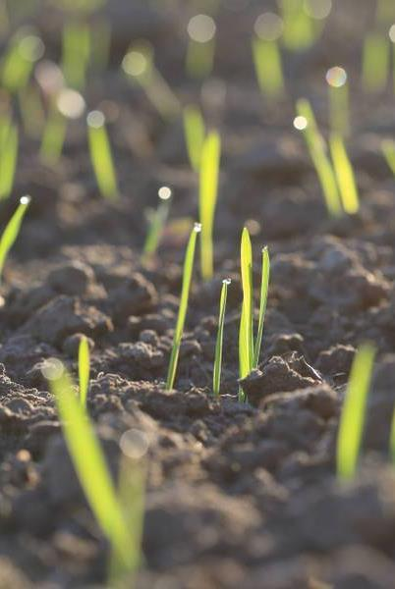
Analysis and explanation of identified problem
The difficulty present among farmers is that they don’t opt for proper crop based on the necessities. Due to this productivity is affected. Selection of crop and fertilizer for that crop is an important issue for agriculture planning. Currently, leading crop yield prediction techniques mostly rely on locally sensed data, such as rainfall measurements and farmer surveys from field visits. Locally sensed data provide detailed information but are expensive to collect, often noisy, and extremely difficult to scale. Geographical data, a cheap and globally accessible resource, coupled with modern deep learning learning approaches offers a potential solution. Approaches utilizing remotely sensed data, potentially provide a cheap, equally effective alternative.

Slide 4
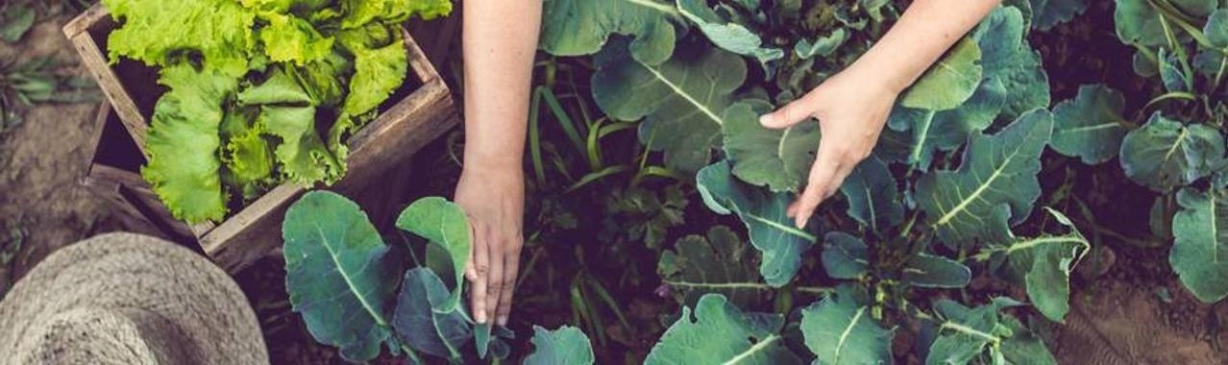
Objective
To predict the crop yield using sequential model and to analyze the performance.
To recommend the crop that is best suitable based on N, P, K and rainfall values.

Slide 5
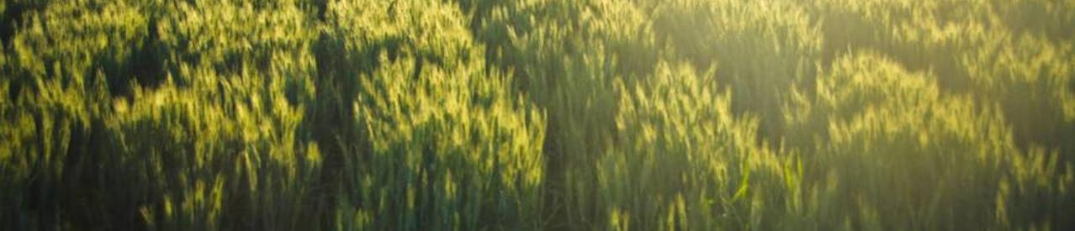
Predicts the crop yield for only wheat crop mainly in India.
Based on Latitude and Longitude values it can predict the yield in a specific region .
Scope

Slide 6
Literature Survey

Slide 7
Crop Yield Prediction Using Remote Sensing and Meteorological Data (2021) [1]
Published In: International Conference on Artificial Intelligence and Smart Systems (ICAIS). IEEE
Methodology:
This paper proposes a framework, which will predict the Crop Yield with the help of various Machine Learning and statistical algorithms.
This model makes use of various algorithms such as XG Boost Regressor, random forest, Light GBM which are based on gradient boosting framework.
Boosting machine learning technique is based on ensemble learning which boosts and enhances the model accuracy and performance .
It aggregates trees and boosts them for better result.
Advantages:
To make farmers aware of the tentative amount of production he will obtain from his field.
Help farmers make monetary and agricultural decisions accordingly.
Disadvantages:
Heavy cost for using high resolution spatial satellite images.
Image processing in Python with for loops are expensive, prone to errors of loop limits

Slide 8
Prediction of crop yield and fertilizer recommendation using machine learning algorithms (2019) [2]
Published In: International Journal of Engineering Applied Sciences and Technology
Methodology:
Crop Yield Prediction can be done using crop yield data, nutrients and location data.
These inputs are passed to Random Forest and Support Vector Machine algorithms.
In fertilizer recommendation suitable crops and required fertilizer for each particular crop is recommended.
Also first it displays weather information of selected location which is displayed by third party API’s.
Advantages:
The prediction of crop yield based on location and have proved that the higher crop yield can be achieved.
For crop yield prediction Support Vector Machine is good with accuracy 99.47%.
Disadvantages:
Mobile application can be build to help farmers by uploading image of farms.

Slide 9
Crop Selection Method to Maximize Crop Yield Rate using Machine Learning Technique (2015) [3]
Published In: International conference on smart technologies and management for computing, communication, controls, energy and materials (ICSTM). IEEE
Methodology:
This paper presents a technique named CSM to select sequence of crops to be planted over season.
Some machine learning techniques like Random forest, support vector machine, k-nearest neighbors are studied and comparative analysis is presented.
The proposed method resolves selection of crop based on prediction yield rate influenced by parameters (e.g. weather, soil type, water density, crop type).
Advantages:
Maximize net yield rate of crop over season and subsequently achieves maximum economic growth of the country.
Disadvantages:
Can improve the prediction rate by using more sophisticated techniques such as boosting techniques.
SVM may not perform well when the dataset is huge.

Slide 10
Crop Recommendation System to Maximize Crop Yield using Machine Learning Technique (2017) [4]
Published In: International Research Journal of Engineering and Technology
Methodology:
This method is characterized by a soil database collected from the farm, crop provided by agricultural experts.
The data from soil testing lab given to recommendation system it will use the collect data and do ensemble model with majority voting technique.
By using support vector machine (SVM) and ANN as learners to recommend a crop for site specific parameter with high accuracy and efficiency.
Advantages:
Help farmers to increase productivity in agriculture, prevent soil degradation in cultivated land.
Reduce chemical use in crop production and efficient use of water resources.
Disadvantages:
An improved data set with large number of attributes.
Also implementing yield prediction.

Slide 11
Estimating Crop Yields With Deep Learning and Remotely Sensed Data (2015) [5]
Published In: IEEE International Geoscience and Remote Sensing Symposium (IGARSS). IEEE.
Methodology:
In this study, we used Convolutional Architecture for Fast Feature Embedding (Caffe) to implement an estimation model of deep learning.
Caffe enables to implement convolutional layers, pooling layers and other algorithms.
Caffe is applied to solve a regression problem of crop yield estimation.
For activation function, rectified linear unit (ReLU) is utilized.
Advantages:
Deep learning is possible to extract important features for crop yields from the input data.
Even though in areas where data acquisition is limited, deep learning is expected to estimate crop yield.
Disadvantages:
The dataset includes very few attributes that would not give accurate predictions.

Slide 12
Heuristic Prediction of Crop Yield using Machine Learning Technique (2019) [6]
Published In: International Journal of Engineering and Advanced Technology (IJEAT)
Methodology:
In this paper, the data sets of different districts of the Telangana state are collected from Telangana State Development Planning Society. The important factors that determine the crop yield are temperature, humidity, soil moisture and rainfall.
Among the data set available maximum of the data was used for training and the remaining data was used for testing. The machine learning technique KNN algorithm was used for prediction of crop yield.
With respect to the application of KNN algorithm towards prediction of crop yield, the nearest neighbors of a particular point (crop yield) like temperature, humidity, rain fall and soil moisture were considered.
Advantages:
KNN as the most appropriate one with maximum accuracy.
Disadvantages:
Does not include recommendation of fertilizers or crops based on the soil, climate and location.

Slide 13
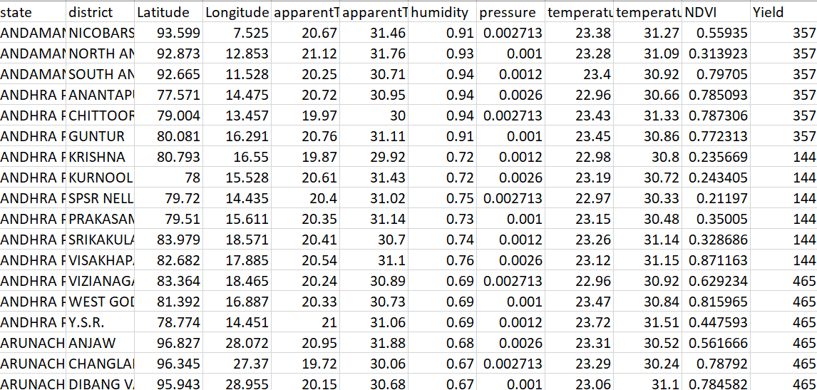
DATA COLLECTION
The dataset consists of different features like latitude, longitude, apparent temperature, pressure, humidity of different districts in India.
Other factors like temperature, NDVI are also taken into consideration to predict the yield of the crop.
Dataset for predicting crop yield:
https://www.kaggle.com/sirpunch/indian-census-data-with-geospatial-indexing
https://aerialintel.blob.core.windows.net/recruiting/datasets/wheat-2013-supervised.csv

Slide 14
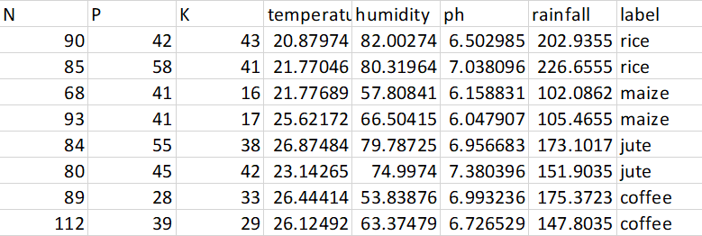
DATA COLLECTION
Dataset for crop recommendation system:
For crop recommendation different features such as N, P, K values, rainfall, pH value are considered.
https://www.kaggle.com/atharvaingle/crop-recommendation-dataset?select=Crop_recommendation.csv

Slide 15
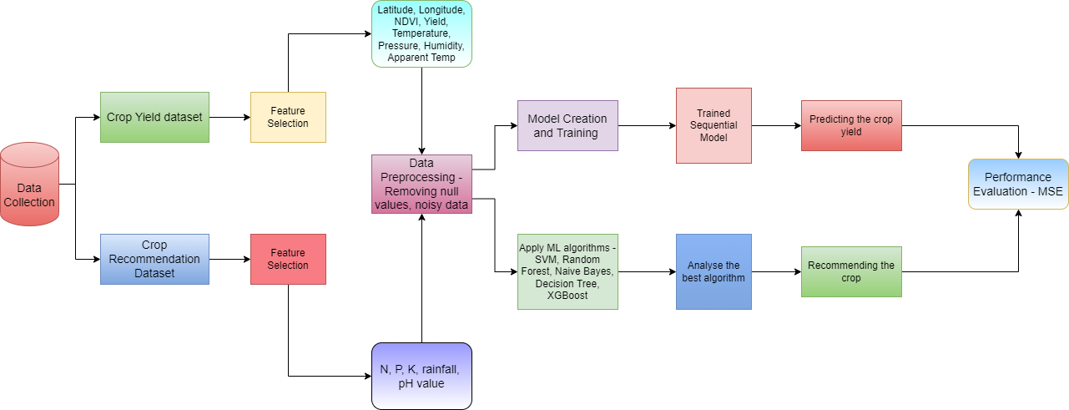
Process flow diagram

Slide 16
Modules
The proposed methodology consists of 3 modules.
Prepare crop dataset and preprocess the data.
Predicting the Yield of a crop.
Recommend the suitable crop based on the soil nutrients.

Slide 17
Prepare crop dataset and preprocess the data
Data is gathered from various sources and then analyzed and combined to obtain a required dataset. This data is utilized for descriptive analysis. The dataset used in this paper consists of various states and districts in India other parameters such as Apparent Temperature, Latitude, Longitude, pressure, dew point, precipitation, Cloud cover, Humidity, NDVI values etc.
In this module, dataset is preprocessed so as to fill the missing values, the fitting information run and separating the usefulness.
Feature selection is used to identify the significant features to give the model before training.
Divide the dataset into 2 parts, One for training and other for testing 70% for training and 30% for testing.

Slide 18
Predict the yield of a crop
A neural network model is created for predicting the yield of the crop.
Sequential model which is a deep learning model is created and trained with the final dataset.
By building an object of the Sequential class and applying model layers to it, deep learning models are constructed.
Sequential model is a collection of neurons organized in a sequence of multiple layers consists of neurons.
The neurons of the network jointly implement a complex nonlinear mapping from the input to the output.

Slide 19
Algorithm:
Step 1: Choose appropriate activation functions-:
The activation function used here is ReLU.(rectified linear activation function ) that will output the input directly if it is positive, otherwise, it will output zero.
R (z) = max(0,z)
Step 2: Number of Hidden Units and Layers- :
Select the optimal number of layers.
add() method is used to add layers to the neural network.
To remove layers, use the pop() method.
Keep on adding layers, until the test error doesn’t improve anymore”

Slide 20
Step 3: Choose a learning rate-:
It governs the learning process of a neural network.
Choose an appropriate value which neither too small nor too large.
Step 4: Train the model-:
The SGD optimization approach is often used to train deep learning neural network models.
It decreases the overall loss.
Step 5: Predict the yield-:
The predict function is used in conjunction with the model class to provide output predictions for input samples in a batch manner.

Slide 21
Recommend crop
Crop recommendation is done by considering different machine learning techniques such as Decision Tree, Naive bayes, SVM, Logistic Regression, Random Forest and Xgboost.
Comparative analysis is made by observing different algorithms.
XGBoost gives the maximum accuracy among all of them.
XGBoost is an ensemble learning method. Sometimes, it may not be sufficient to rely upon the results of just one machine learning model.
Ensemble learning offers a systematic solution to combine the predictive power of multiple learners.
The resultant is a single model which gives the aggregated output from several models.
Therefore, Xgboost is used to recommend the crop.

Slide 22
Algorithm:
Step 1: Load all the libraries of corresponding algorithms.
Step 2: Load the final dataset after pre-processing.
Step 3: Select the required features which contribute more to the recommendation.
Step 4: Find the accuracy of all algorithms that are Decision tree, Naive bayes, SVM, Logistic regression, Random Forest and Xgboost for the given dataset.
Step 2: Compare the accuracy of all the models.
Step 3: Predict the crop recommendation using the model which is having the high accuracy.

Slide 23
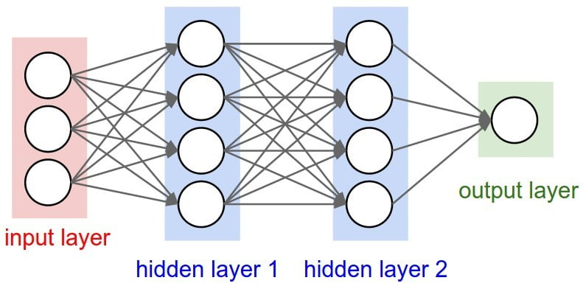
Basic concepts
Deep Neural Networks (DNN)
A deep neural network (DNN) is an artificial neural network (ANN) with multiple layers between the input and output layers.
At first, the DNN creates a map of virtual neurons and assigns random numerical values, or "weights", to connections between them.
There are various algorithms in deep learning such as Artificial Neural Networks(ANN), Convolution Neural Network(CNN), Recurrent Neural Network(RNN), Feed forward Neural Network etc.

Slide 24
CROP YIELD
In agriculture, the yield is a measurement of the amount of a crop grown, or product such as wool, meat or milk produced, per unit area of land.
Innovations, such as the use of fertilizer, the creation of better farming tools, new methods of farming and improved crop varieties, have improved yields.
The higher the yield and more intensive use of the farmland, the higher the productivity and profitability of a farm; this increases the well-being of farming families.

Slide 25
SGD OPTIMIZATION
Stochastic gradient descent (SGD) algorithm is used in our model to learn the best set of weights and biases of the neural network that minimize the loss function.
While learning, the SGD algorithm works by randomly choosing a small number of training inputs, which is referred as Batch size.
SGD randomly picks one data point from the whole data set at each iteration to reduce the computations enormously.
The advantages of Stochastic Gradient Descent are:
Efficiency
Ease of implementation

Slide 26
XGBOOST
XGBoost is a technique of ensemble learning. Ensemble learning is a method for combining the prediction performance of several learners in a structured way.
Ensemble modeling is a useful tool for improving your model's performance. The ensemble's foundation learners, or models, may be from the same or various learning algorithms.
Decision trees are constructed sequentially in this approach. In XGBoost, weights are very significant.
In XGBoost, gradient boosted decision trees are developed. Weights are assigned to each of the independent factors, which are then fed into the decision tree, that anticipates outcomes.

Slide 27

Implementation:
Home Page

Slide 28
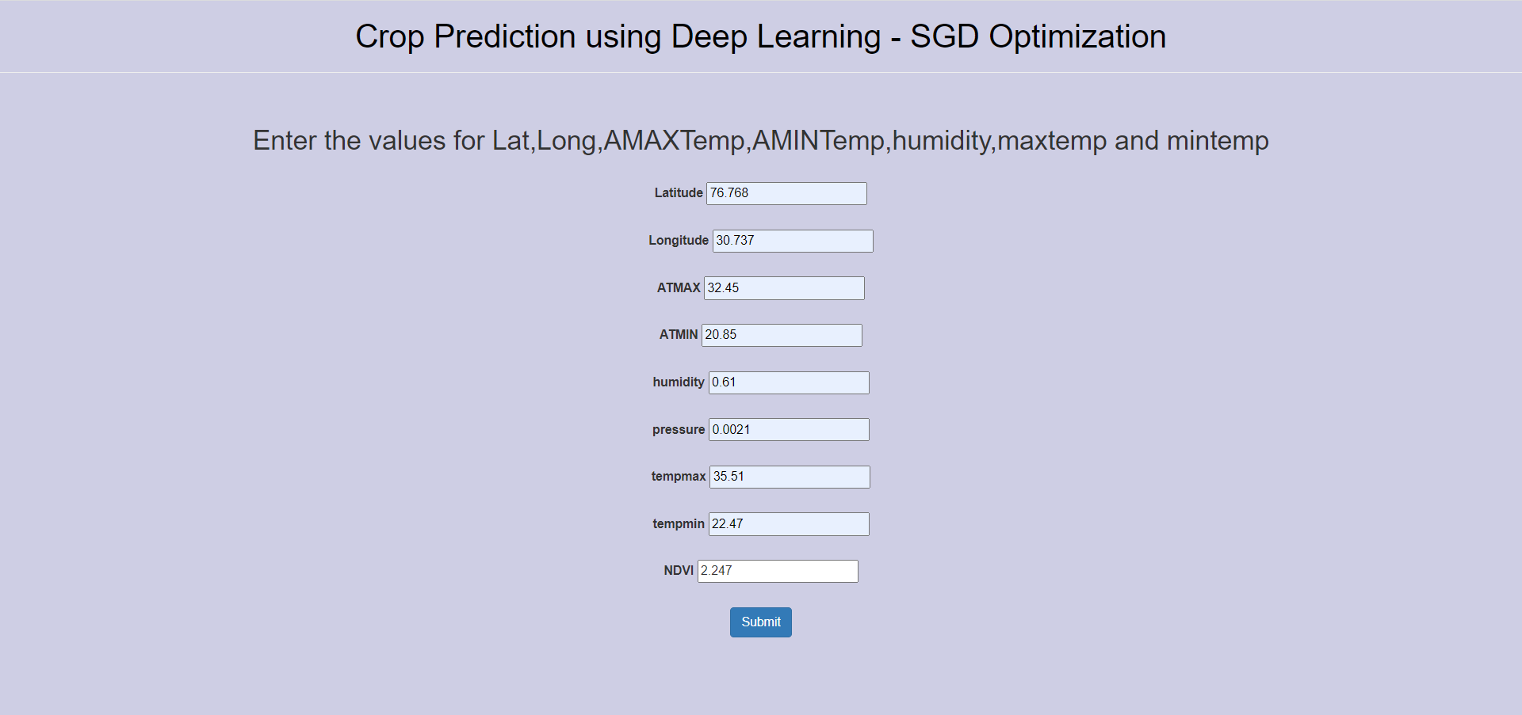
Enter the values to get the suitable yield

Slide 29
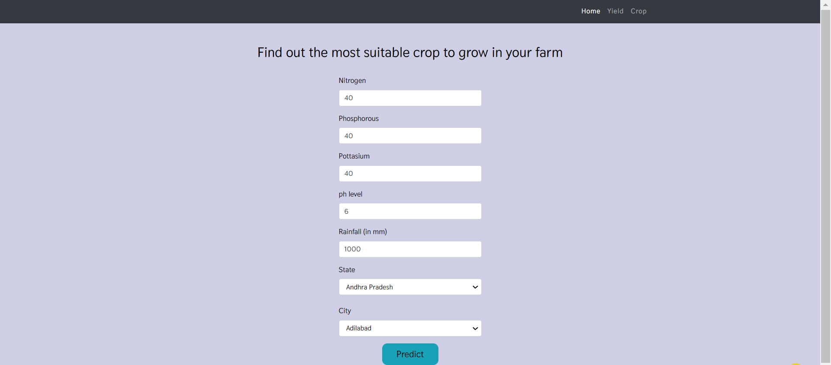
Enter the values to get the suitable crop

Slide 30
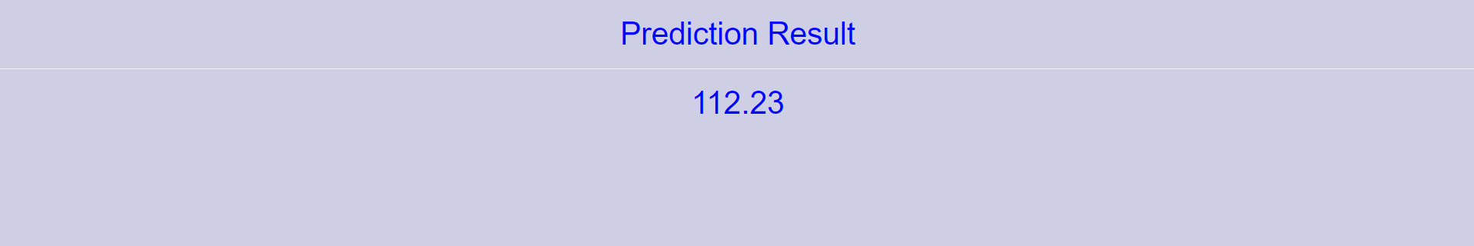
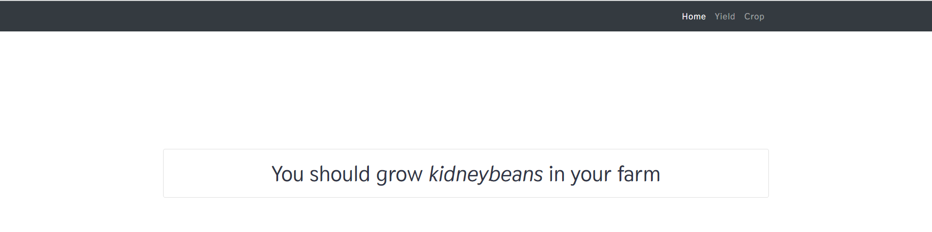
Predicted Yield in Kg/ha
The recommended crop is kidney beans

Slide 31
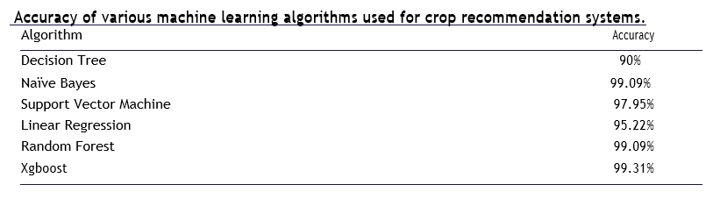
Results:
The model that has been trained can predict crop yield and recommend the suitable crop with high accuracy.
The model developed gives the accuracy of 99.3% in all the states of India for the crops during all the seasons.

Slide 32
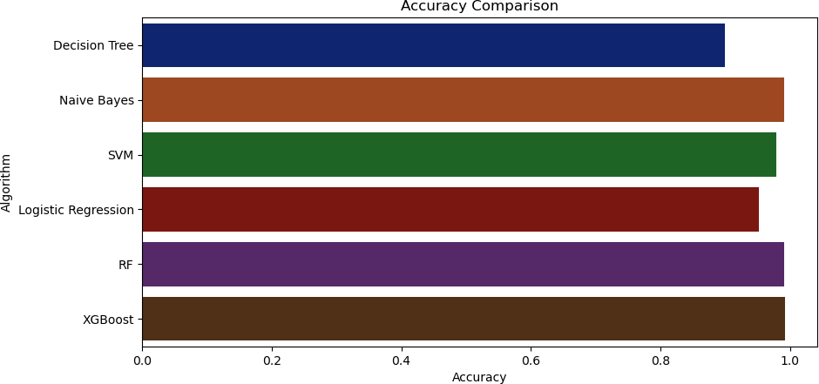
Our model takes the input values such as Latitude, Longitude, Apparent temperature, pressure, humidity, Temperature maximum, Temperature minimum, NDVI entered by the user in a web page interface displays the predicted yield of a crop in Kilogram (kg) per hectare.
A crop recommender suggests a suitable crop based on the XGBoost technique.

Slide 33
Conclusion:
Finally, a neural network model for predicting agricultural yields was developed, it is effective in predicting crops.
Crop recommendation is also a feature of this system that helps farmers to get the most suitable crop on their farm.
Using the most accessible technologies, this effort provides direct advising facilities to a farmer in his minimum area.
A crop production model can be used by farmers to help them decide what to plant and when to plant it. It acts as a support system for the farmer to help him to improve his farming activities and maximize productivity.

Slide 34
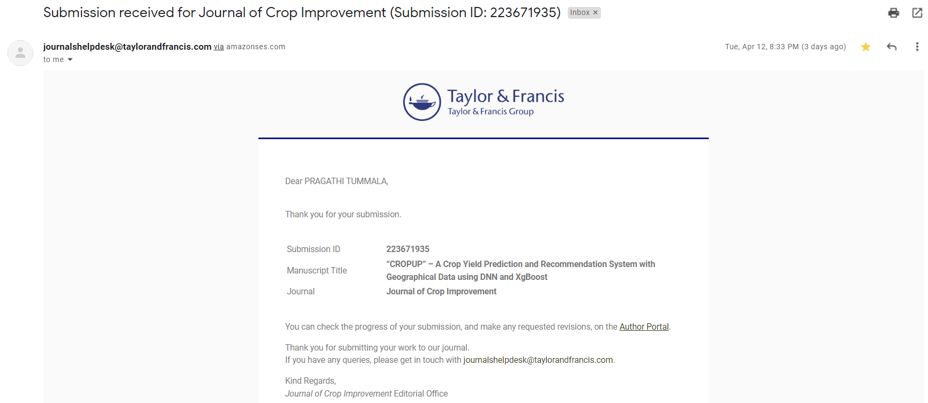
Publication Status:

Slide 35
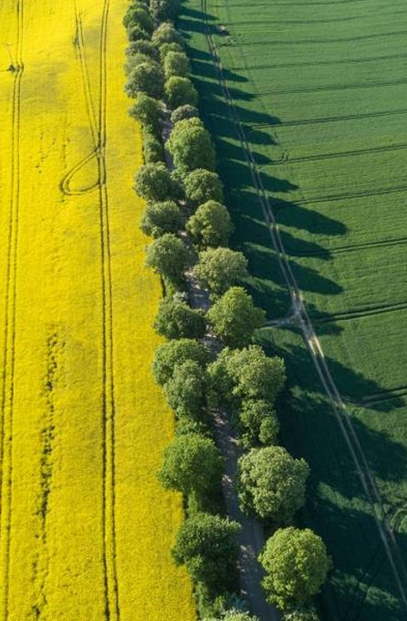
TIME PLAN of project
TASK | DATE
Project Title | 31/01/22
Abstract | 07/02/22
Objective and Scope | 14/02/22
Analysis of identified problem, Data collection, Methodology | 14/03/22
Report on Abstract, Introduction and Literature Survey | 28/03/22
Report on design, Algorithm, Coding | 11/04/22
Implementation and Testing | 11/04/22
Rough Draft | 28/04/22
Final Dissertation | 03/05/22

Slide 36
references
Shah, Avnika, Rhea Agarwal, and B. Baranidharan. "Crop Yield Prediction Using Remote Sensing and Meteorological Data." 2021 International Conference on Artificial Intelligence and Smart Systems (ICAIS). IEEE, 2021.
Bondre, Devdatta A., and Santosh Mahagaonkar. "Prediction of crop yield and fertilizer recommendation using machine learning algorithms." International Journal of Engineering Applied Sciences and Technology 4.5 (2019): 371-376.
Kumar, Rakesh, et al. "Crop Selection Method to maximize crop yield rate using machine learning technique." 2015 international conference on smart technologies and management for computing, communication, controls, energy and materials (ICSTM). IEEE, 2015.
Rajak, Rohit Kumar, et al. "Crop recommendation system to maximize crop yield using machine learning technique." International Research Journal of Engineering and Technology 4.12 (2017): 950-953.
Kuwata, Kentaro, and Ryosuke Shibasaki. "Estimating crop yields with deep learning and remotely sensed data." 2015 IEEE International Geoscience and Remote Sensing Symposium (IGARSS). IEEE, 2015.
Pavani, S., and A. S. Beulet. "Heuristic prediction of crop yield using machine learning technique." International Journal of Engineering and Advanced Technology (IJEAT) (2019): 135-138.

Slide 37
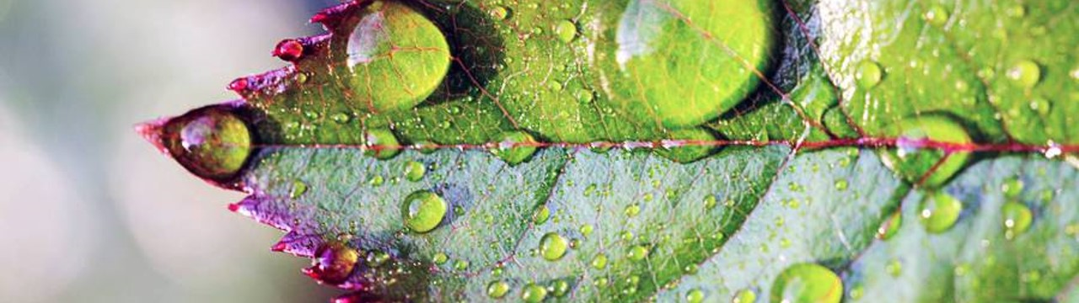
THANK YOU

